Slide 1
Takashi Ikegami
Scientist & Artist

Slide 2
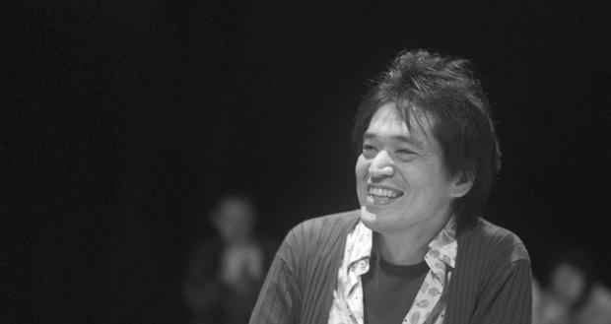
Takashi (alternatively spelled Takahashi)

Slide 3
Background
PhD in Physics from University of Tokyo, 1987.
Professor in Department of General System Studies at University of Tokyo.
Researching Complex Systems and Artificial Life.
Wrote a book, “Life Emerges in Motion”; can’t find it anywhere.
Has a very frustrating website for his laboratory!
Lots of collaborations with psychologists, musicians, chemists/physicists, and more.
Appears to have a number of patents.
And a lot of publications! 8 journal publications in ‘14. 33 since ‘10.
Relative newcomer to the field.

Slide 4
A-Life Research Areas
Chemical A-Life
Self-moving oil droplets behaving like fatty acids.
Robotics
Experiments with redundant sensor networks.
Computer Simulations
Several things, esp. neural networks.
Group evolution, communication evolution.

Slide 5
Art + Science = ?
Major themes of abstract audiovisual art and sound art.
Collaborations with sound (noise?) artists, providing visual neural network responses to the music. Very chaotic!

Slide 6
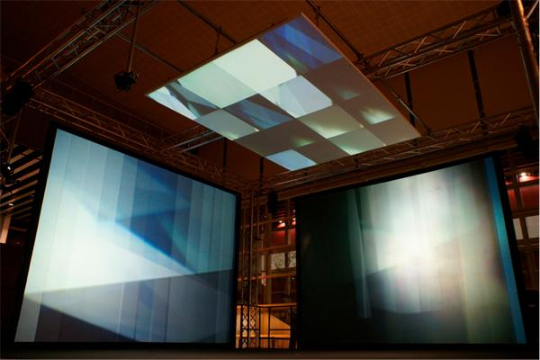
Mind Time Machine

Slide 7
Senses → Mind
Sensory overload “massive data flow” used on empty (untrained) neural network.
Neural network evolves around its senses! Gains patterns and engages in visual “thinking”.

Slide 8
Mind Time Machine
3 large screens, 15 video cameras
Uses neural networks and video feedback for learning and pattern recognition.
Very chaotic looking, but interesting patterns. When space is empty, can still watch machine “think”.

Slide 9
MTM Video

Slide 10
MTM Cont’d
Responds to its environment (quiet on rainy days) and has daily patterns (less active in the morning, very active at night).
Can be interacted with; people can stand inside it, and contribute to the sensory input.

Slide 11
Philosophical Takeaways
Maximalism vs minimalism.
Senses → intellect, not vice versa?
Feedback as memory.
Not trying to solve a problem, just an experiment!

Slide 12
Other Research
The MTM appears to be a culmination of much of his research - a “life’s work so far”.
Sensor networks, human-computer interaction, neural networks, robotics. Giving artificial agents senses of time, self, and deep perception of their surroundings.

Slide 13
Other Research
Can’t find videos on most of his stuff :(
Autonomous Sensor Network “Sound Bookshelf”
Training agent simulations to account for time in estimating distance and resource renewal rates.

Slide 14
Other Research Pictures

Slide 15
Motility at the Origins of Life

Slide 16
More videos
Big Picture Complexity TEDx talk (9 min)
Using the MTM to accompany live noise music. (6 min)
TedTalent talk: "The case of complexity over simplicity", (5 min)
Cellular Automata Cell forming (2 min)

Slide 17
Impressions
Does not seem to have a big ego.
On the flip side, big egos make themselves easy to research. Good with the bad.
Interests seem to parallel mine: more interested in the aesthetics than the usefulness.

